Slide 1
Allstate/Stanford Research Update: Observation Noise
Shubh Gupta
Nov 2, 2020

Slide 2
AST Framework
Likelihood
Reward
Reward Function
Event
AST Solver
Environment Actions
Agent #1
Agent #N
…
(Sensor/control noise)
Simulator

Slide 3
Observation Noise in Simulator - 1
Simulator
Used for driving decisions
SUT
Agent #1
Agent #N
Actual States:
…
SUT
Agent #1
Agent #N
Noisy States:
…
Environment Actions

Slide 4
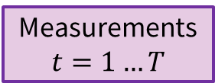

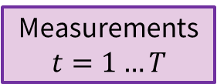
Observation Noise in Simulator - 1
Simulator
Used for driving decisions
SUT
Agent #1
Agent #N
Actual States:
…
SUT
Agent #1
Agent #N
Noisy States:
…
Measurements
$$t=1…T$$
Measurements
$$t=1…T$$
Measurements
$$t=1…T$$
Environment Actions

Slide 5
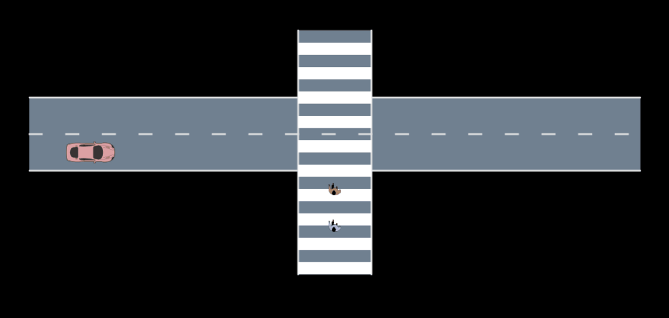
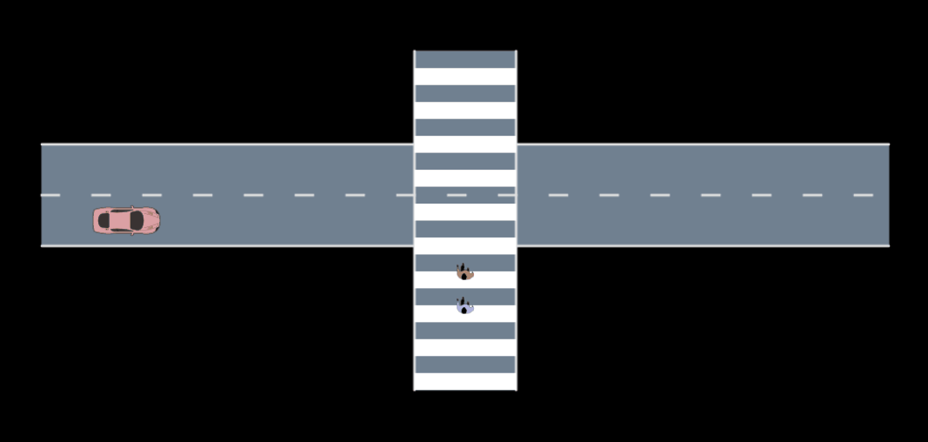
Position tracking using Speed Measurements (Gaussian Noise)
Failure mode (manual) with constant noise
Failure mode (AST)
Actual Position
Noisy Position

Slide 6
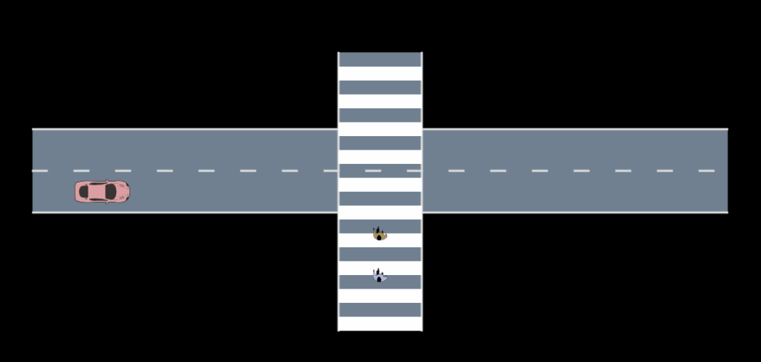
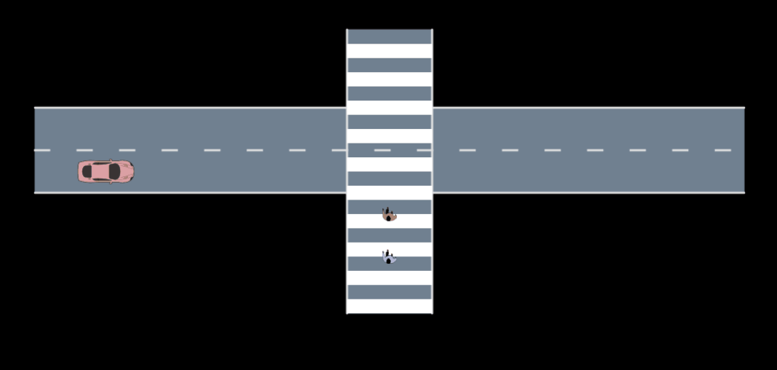
Position estimation using GPS Range Measurements (Gaussian Noise)
Fixed noise (manual) in GPS measurements
Failure mode (AST)
Actual Position
Noisy Position

